Slide 1

THRILLER PROJECT!!
Week 1:
Your ideas !
Discuss the key themes of the music video. Choreograph the opening section to thriller
Week 2:
Recap ideas from week 1.
Choreograph middle section of thriller using your own ideas
Week 1:
Watch the thriller dance video
Week 7:
Watch the videos & analyse
Week 3
Complete your thriller dance choreography
Week 3:
Rehearse your Thriller Dance choreography and perform
REHEARSE YOUR THRILLER DANCE ROUTINE.

Slide 2

Lesson Objective: 1.Rehearse the opening to your thriller dance routine. 2.Choreograph the middle section of your dance thinking about which choreographic devices you can use

Slide 3
Success Criteria
Level | Dance Strand
 | 1 Creating | 2 Performing | 3 Reflecting
E Entry | I can remember a range of actions I can create phrases based on a stimulus or music | I can participate in a short group performance I show some consideration of spatial awareness in performance | I can recognise when my own work and the work of others’, could be improved
1 G | I can perform simple dance phrase demonstrating choreographic skills | I can use appropriate characterisation in a performance | I can talk about why I made certain decisions in my choreography I can show a basic understanding of how a stimuli can be conveyed
2 F | I can create a choreography using unison and cannon I can learn teacher led sequences and then use these to develop my own levels I can create a choreography using a range of stimuli I can take on feedback to improve my choreography such as using levels and/or contract work I can sustain a focus within a performance | I can learn a routine and take part in simple performances | I can give suggestions on how work could be improved I can talk about my work using some dance terminology I can identify strengths and weaknesses in my own and others work
3 E | I can select and apply movement to match the given dance style I can work confidently in a group using a range of choreographic devices to explore different dance styles and ideas I can create and rehearse performance that make use of the range of techniques and dynamics to express my ideas I can give and accept suggestions to/from peers and teachers during the rehearsal process I can learn and create dances in a variety of styles | I experiment with different actions to create a performance I can create routines that are appropriate to the given style or stimuli I can experiment with different styles/actions and dynamics when developing a routine I improve and refine my performance through the rehearsal process I can choreograph a short performance for an audience I can perform a variety of different dance styles | I can reflect on and evaluate my own and other pupils’ work, suggesting improvements I can use key words when talking about dances that I have seen or participated in I can discuss the ways that ideas are communicated

Slide 4
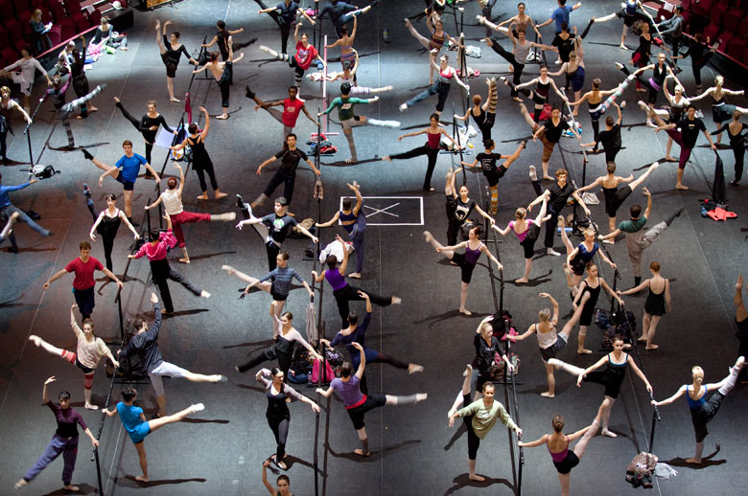
WARM UP
WHAT ARE THE 3 ELEMENTS OF A WARM UP?
WHY DO WE NEED TO WARM UP?

Slide 5

RECAP!!!!!

Slide 6
KEY CONCEPTS OF CHOREOGRAPHY
BEGINNING, MIDDLE AND END OF A ROUTINE
STARTING POSITION
ENDING POSITION
USE OF UNISON- (WHEN YOU PERFORM AT THE SAME TIME)
USE OF CANON- (WHEN YOU PERFORM ONE AT A TIME)
REPETITION

Slide 7
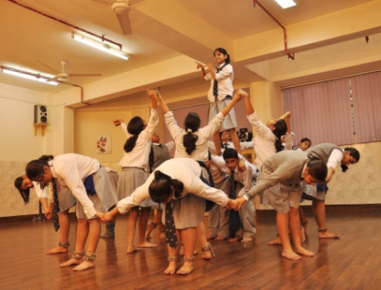
RECAP OPENING POSITION TO YOUR THRILLER DANCE
THINK ABOUT YOUR FORMATION- WHAT DOES FORMATION MEAN?
LEVELS- High medium and low

Slide 8

TASK CREATE THE MIDDLE SECTION OF YOUR ROUTINE
WHAT DO YOU NEED TO THINK ABOUT?
WORKING TOGETHER
COMMUNICATE WITH GROUP EFFECTIVELY
UNISON
CANON
CHANGING SPEEDS
CHANGING DYNAMICS
USE OF DIFFERENT LEVELS

Slide 9
PERFORMANCE TIME
PERFORM YOUR ROUTINE TO THE REST OF THE CLASS
WHAT DO YOU NEED TO THINK ABOUT?.
Where you are looking
Ensure your formation is clear
Ensure your movements are in time with the music.
Ensure you and your group know exactly what they are doing.

Slide 10
PLENARY
WHAT DOES CANNON MEAN?
WHAT DOES UNISON MEAN?
WHAT ARE THE 3 LEVELS YOU CAN USE IN CHOREOGRAPHY?
WHAT IS MOVEMENT MEMORY?

